Slide 1

JAYPEE INSTITUTE OF INFORMATION & TECHNOLOGY, SECTOR – 62, NOIDA
Physics – 2
project based learnig
Hard disks (hdd)
Submitted By:
Aryaman Vishnoi (21103260)
Rohan Siwach (21103261)
Parush Sharma (21103259)
Himanshu Dixit (21103262)
Submitted to:
Dr. Ravi Gupta Sir

Slide 2


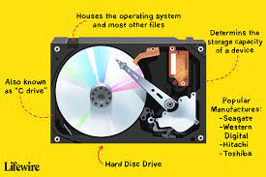
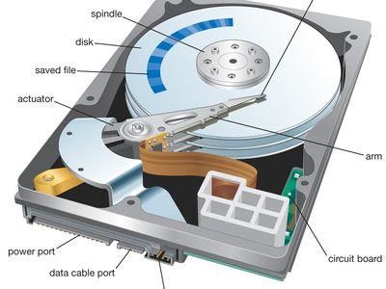
HDD – HARD DISK DRIVE
Who Invented The Hard Disk?
The hard disk drive was originally invented by an IBM team led by Rey Johnson in 1954. However since his teams invention of the technology significant improvements have been made.

Slide 3

CONTENTS
INTRODUCTION
ARCHITECTURE OF SSD
MAIN COMPONENTS
DISK STRUCTURE
STORAGE CAPACITY
COMPARISON OF HDD & SSD
ADVANTAGES & DISSADVANTAGES
THE PROBLEMS WITH TODAY’S HARD DISKS
APPLICATIONS OF HDD
CONCLUSION
REFRENCES

Slide 4

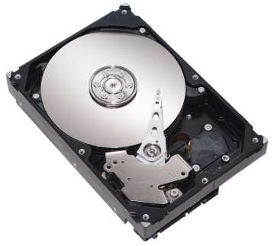




Hard Disk what is Hard disk?
Platters Spindle
Read/Write head Actuator
HDD
Input
Device
Output
Device
RAM
CPU

Slide 5
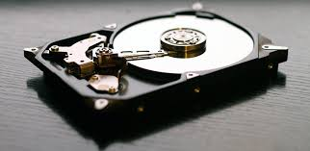
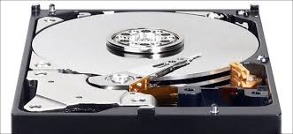
INTRODUCTION
A HARD DISK DRIVE (HDD) is a data storage device used for storing and retrieving digital information using rapidly rotating disks (platters) coated with magnetic material. An HDD retains its data even when powered off. Data is read in a random-access manner, meaning individual blocks of data can be stored or retrieved in any order rather than sequentially.

Slide 6
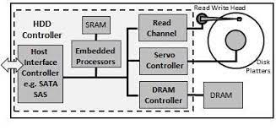
ARCHITECTURE OF HDD
Simple block diagram of HDD architecture

Slide 7
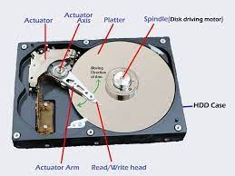
MAIN COMPONENTS FOR HARD DISK DRIVE :- 1. DISK PLATTER 2. STEPPER MOTOR 3. SPINDLE MOTOR 4. READ AND WRITE HEAD 5. ARM

Slide 8
DISK STRUCTURE
TRACK :-
The HDD is divided into number of concentric circles called tracks, Circular path in sector is called track.
SECTOR :-
Data storage area in one track multiple divided into the multiple block is called sector. Each sector can have 512 bytes of the data.
CYLINDER :-
A set of corresponding tracks in all sides of a hard disk is called cylinder.

Slide 9
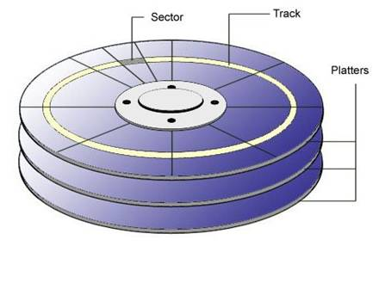
STORAGE CAPICITY :- Its having a formula shown below: Storage capacity = number of cylinder’s * tracksper cylinder * Sector per tracks * bytes per sector.

Slide 10
Technical Comparison of SSD & HDD
Solid-state drive Hard disk drive
Random access time
0.1 ms
Random access time
5~10 ms
Read latency time
Very low
Read latency time
high
100MB/s to 500MB/s
50MB/s to 100MB/s
High Reliability
SSDs have no moving parts to fail mechanically
Low Reliability
HDDs have moving parts and are subject to sudden failure
Small and light in weight
Relatively large and heavy
In 2013 SSDs were available in sizes up to 512GB
In 2013 HDDs of up to 4TB were available
power consuption 2 watts
12 watts.
As of 2013 NAND flash SSDs cost
about Rs.31000 for 500GB
As of 2013 HDDs cost about Rs.3200
for 500GB drives

Slide 11


Slide 12
ADVANTAGES OF HDD
Cost :–
A conventional hard drive will in general be less in cost than a Solid state drive of a similar limit. On generally speaking a framework that contains hard plate drive as the capacity gadget won’t be expensive. Purpose for this is on grounds that the creation cost for a HDD is altogether lower.
Capacity :–
Limit as far as capacity limit there are different bigger alternatives accessible for a client in HDD. And furthermore the base limit of a HDD is normally higher than a SSD. Regardless of different stockpiling limit choices, the standard limit that most clients lean toward has discovered to be 500GB.
Accessibility :–
Both the inside and outside hard drives are generally bountiful on the lookout. For the clients who are hoping to update their PC or construct another framework can undoubtedly locate a hard plate drive. In the interim buying a Solid state drive can be a harder errand due to their market requests. life.

Slide 13
ADVANTAGES OF HDD
Life Expentancy Another Bitt :–
Life expectancy Another bit of leeway of utilizing a HDD is its life expectancy. A SSD has limited number of read/compose cycles which can be taken care of by the glimmer recollections. Not at all like a SSD there is no blaze recollections associated with HDDs.
Non-Volatile :–
All the unpredictable memory gadgets present on your PC watches out for free its information once it is running out of intensity. In this way, these sorts of recollections can’t be utilized to stack working frameworks and dispatch applications. Maybe the answer for the non-unstable memory is the hard plate drive.
Moving Parts :–
Hard drives contain a few moving parts inside a walled in area. These incorporate turning plates and a fragile arm. Having moving parts implies the hard drive is inclined to harm and peruse or compose mistakes in the event that it is moved too energetically or time after time without adequate security.

Slide 14
DISADVANTAGES OF HDD
Speed Hard :–
Drives have a more slow normal speed than any type of blaze memory. A hard drive sets aside a short effort to get to the right area of information on its plates, while a strong state drive gets to information immediately.
Structure Factor :–
Another significant disservice present in a hard circle drive is its enormous structure factor. In light of the presence of mechanical parts, a hard drive can’t be made more modest than a specific breaking point.
Force Consumption :–
For composing information, HDDs continually depends upon the revolution of platter circles and the development of read/compose head. These mechanical parts need a force contribution for them to work. This is one of the essential reasons why makers consider SSDs in the event that they construct a PC with restricted battery life.

Slide 15
DISADVANTAGES OF HDD
Clamor :–
As we as a whole realize that hard drives comprises of mechanical parts. Because of the steady turn of the platter circles and the development of read/compose head there is a diverting commotion created by the hard drive. This likewise adds to vibrations.
Mechanical Failure :–
Hard circle drive is more defenseless against mechanical disappointments since they contain moving parts. The platter circles and the read/compose head present in a HDD is situated in closeness to one another. In this way, at whatever point there is a drops and shivers they can scratch each other causing harms.

Slide 16
The problems with today’s Hard Disks?
Hard Disk Drives
Processors have increased in speed by orders of magnitude over the years.
But spinning hard disk drives (HDD) have not.
Performance gap between how fast processors demand data and how quickly HDD responds.
HDD speed lags behind processors because it is constrained by physical components.

Slide 17
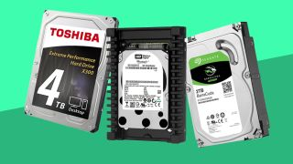
HDD APPLICATIONS
Servers
Backup
Desktop computers
Laptops
Smart Tv
CCTV Digital Video Recorder (DVR)
Set-Top Boxes
Gaming Consoles

Slide 18
CONCLUSION
A hard disk has revolutionized the digital ageas we know it. Hard disks are the most widelyused technology for storage of our informationand data. Without hard disks the computer digitalage we live in would not be the same.

Slide 19
REFRENCES
https://en.wikipedia.org/wiki/Hard_disk_drive
https://www.slideshare.net/achyutneupane/hard-disk-project
www.google.com
https://www.techopedia.com/definition/5288/hard-disk-drive

Slide 20
THANK YOU….

